Slide 1
Unit 5 State Space analysis

Slide 2
Syllabus
Advantages of State Space Analysis over Classical Control , Concept of State , State Variables
State Model , State Space Representation using State Model, State Transition Matrix and its properties,
Solution of State Equations for LTI System ,
Concept of Controllability and Observability

Slide 3
Outline
How to find mathematical model, called a state-space representation, for a linear, time-invariant system
How to convert between transfer function and state space models

Slide 4
Drawbacks of Transfer function
Defined under Zero initial conditions
Applicable only to Linear Time Invariant systems
Limited to SISO
Classical methods based on Trial & Error methods
Not applicable for MIMO

Slide 5
Advantages of state space analysis
Use of Vector Matrix notation simplifies the mathematical representation of the system
Allows inclusion of initial conditions
Used to represent Non-linear as well as Time-Variant systems
Analysis for state space can be carried out for an class of inputs without much complexity

Slide 6
State-Space Modeling
Alternative method of modeling a system than
Differential / difference equations
Transfer functions
Uses matrices and vectors to represent the system parameters and variables
In control engineering, a state space representation is a mathematical model of a physical system as a set of input, output and state variables related by first-order differential equations.
To abstract from the number of inputs, outputs and states, the variables are expressed as vectors.

Slide 7
Motivation for State-Space Modeling
Easier for computers to perform matrix algebra
e.g. MATLAB does all computations as matrix math
Handles multiple inputs and outputs
Provides more information about the system
Provides knowledge of internal variables (states)
Primarily used in complicated, large-scale systems

Slide 8
Terminology of State Space
State
State Variables
State Vector
State Space

Slide 9
Definitions
State-
The state of a dynamic system is the smallest set of variables (called state variables) such that knowledge of these variables at t=t0 , together with knowledge of the input for t ≥ t0 , completely determines the behavior of the system for any time t to t0 .
It is group of variables, which summarizes the history of the system in order to predict the future values.

Slide 10
State Variables:
The state variables of a dynamic system are the variables making up the smallest set of variables that determine the state of the dynamic system.
If at least n variables x1, x2, …… , xn are needed to completely describe the behavior of a dynamic system, then such n variables are a set of state variables.

Slide 11
State Vector:
A vector whose elements are the state variables.
If n state variables are needed to completely describe the behavior of a given system, then these n state variables can be considered the n components of a vector x. Such a vector is called a state vector.
A state vector is thus a vector that determines uniquely the system state x(t) for any time t≥ t0, once the state at t=t0 is given and the input u(t) for t ≥ t0 is specified.

Slide 12
State Space:
The n-dimensional space whose coordinate axes consist of the x1 axis, x2 axis, ….., xn axis, where x1, x2,…… , xn are state variables, is called a state space.
"State space" refers to the space whose axes are the state variables. The state of the system can be represented as a vector within that space.

Slide 13
State-Space Equations
In state-space analysis we are concerned with three types of variables that are involved in the modeling of dynamic systems:
Input variables,
Output variables, and
State variables.

Slide 14
Contd…
The number of state variables to completely define the dynamics of the system is equal to the number of integrators involved in the system.
Assume that a MIMO system involves n integrators.
Assume also that there are r inputs u₁(t), u₂(t),……. u_{r}(t) and m outputs y₁(t), y₂(t), …….. y_{m}(t).

Slide 15
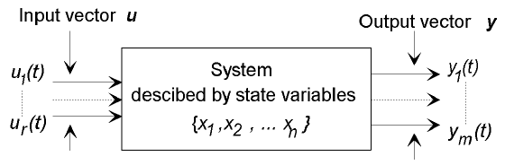
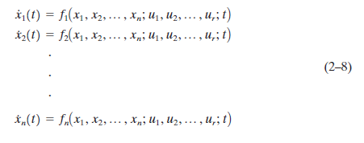
Define n outputs of the integrators as state variables: x₁(t), x₂(t), ……… x_{n}(t). Then the system may be described by

Slide 17
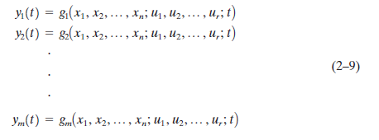
The outputs y₁(t), y₂(t), ……… y_{m}(t) of the system may be given by

Slide 18
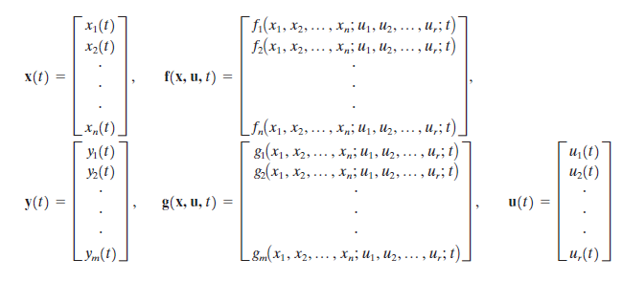
If we define

Slide 19

then Equations (2–8) and (2–9) become
where Equation (2–10) is the state equation and Equation (2–11) is the output equation. If vector functions f and/or g involve time t explicitly, then the system is called a time varying system.

Slide 20

If Equations (2–10) and (2–11) are linearized about the operating state, then we have the following linearized state equation and output equation:

Slide 21
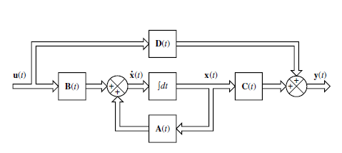
A(t) is called the state matrix,
B(t) the input matrix,
C(t) the output matrix, and
D(t) the direct transmission matrix.
A block diagram representation of Equations (2–12) and (2–13) is shown in Figure

Slide 22

If vector functions f and g do not involve time t explicitly then the system is called a time-invariant system. In this case, Equations (2–12) and (2–13) can be simplified to
Equation (2–14) is the state equation of the linear, time-invariant system and
Equation (2–15) is the output equation for the same system.

Slide 23


Correlation Between Transfer Functions and State-Space Equations
The "transfer function" of a continuous time-invariant linear state-space model can be derived in the following way:
First, taking the Laplace transform of
Yields

Slide 24
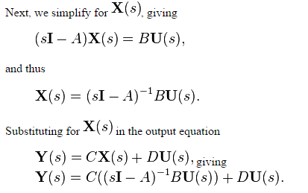

Slide 25
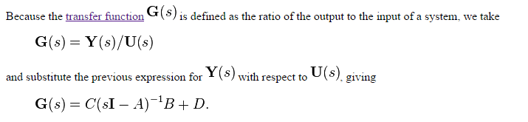

Slide 26
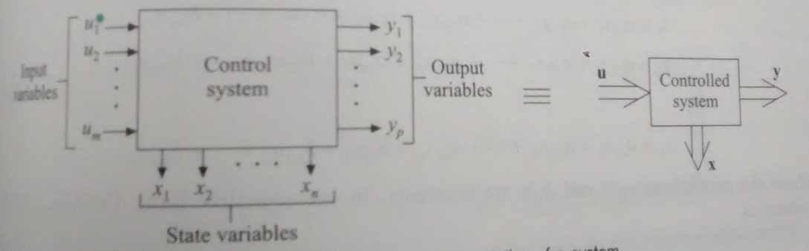
State-Space Representation
State Variable techniques involves:
Input Variables (u)- (m inputs)– input vector U(t) (r*1)
Output Variable (y)- (p outputs)– output vector Y(t) (m*1)
State variable (x)- (n state variables)--- State vector X(t) (n*1)

Slide 27
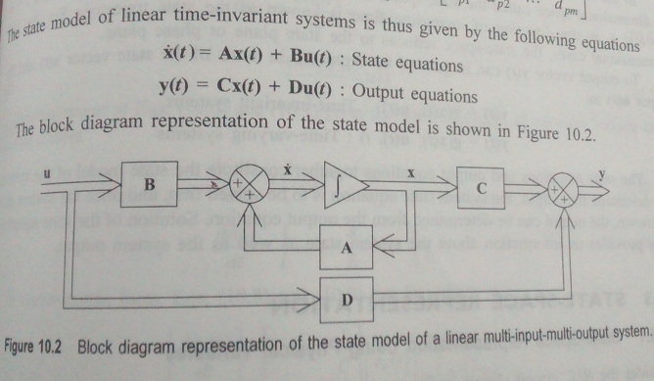
State Model

Slide 28
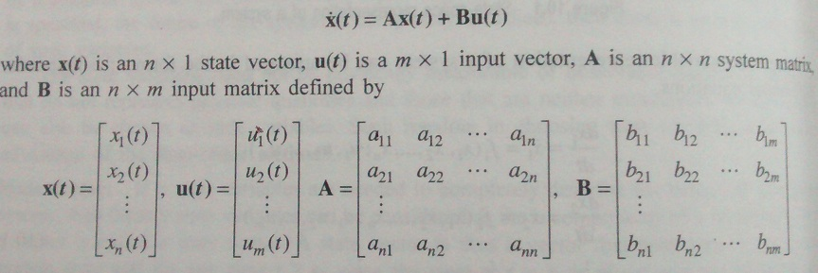
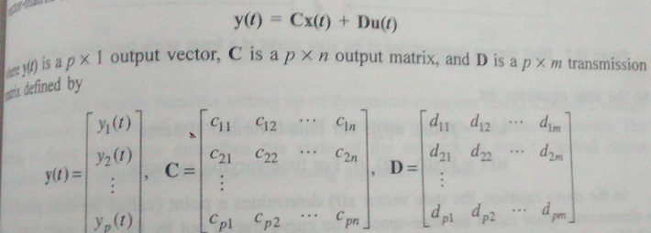

Slide 29
State Transition Matrix
The behavior of x(t) et y(t) :
Homogeneous solution of x(t)
Non-homogeneous solution of x(t)

Slide 30
Solution of Homogeneous state eq
State Transition Matrix

Slide 31
Properties

Slide 32
How to find
State transition matrix
Method 1:
Method 2:
Method 3: Cayley-Hamilton Theorem

Slide 33
Methode 1:

Slide 34
Methode 2:
diagonal matrix

Slide 35
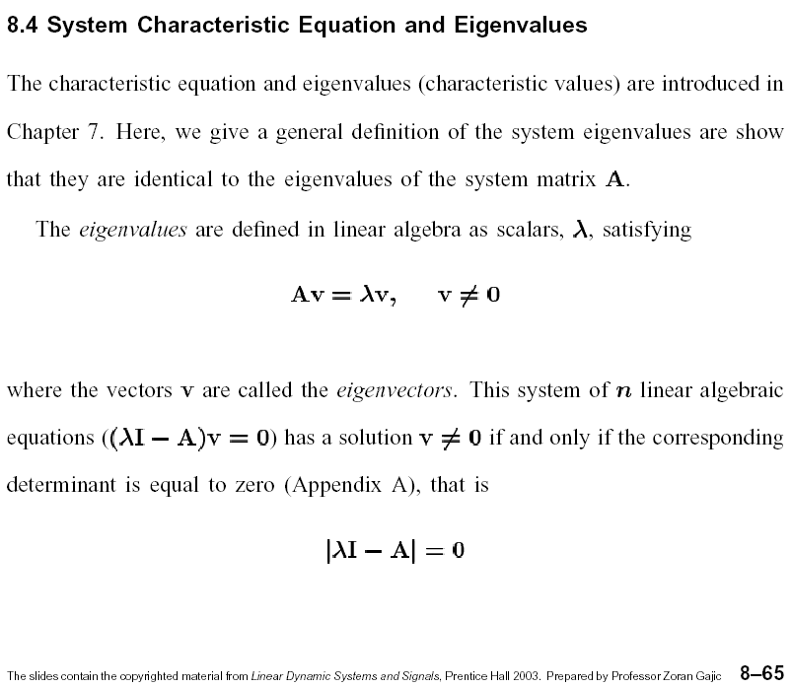
Diagonization

Slide 36
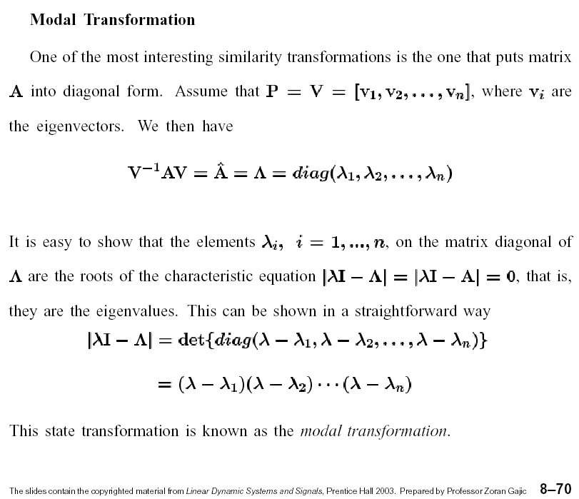
Diagonization

Slide 37
Case 1:
depend

Slide 38
In the case of A matrix is phase-variable form and
Vandermonde matrix
for phase-variable form

Slide 39
Case 1:
depend

Slide 41
Case 3:
Jordan form
Generalized eigenvectors

Slide 42
Example:

Slide 43
Observability & Controllability

Slide 44
Definition
A linear system is said to be completely controllable if, for all initial times and all initial states , there exists some input function (or sequence for discrete systems) that drives the state vector to any final state at some finite time .
Definition
A linear system is said to be completely observable if, for all initial times , the state vector can be determined from the output function (or sequence) , defined over a finite time .

Slide 45
Proof of controllability matrix
Initial condition

Slide 46
Proof of observability matrix
Inputs & outputs

Slide 47
Linear system
1. Analysis
Controllability matrix
Observability matrix
Then: (1) controllable
(2) observable

Slide 48
Linear system
1. Analysis
Example 1
uncontrollable
observable
The rank of a matrix is defined by the number of linearly independent rows and/or the number of linearly independent columns

Slide 49
Linear system
1. Analysis
Example 2
controllable
unobservable

Slide 50
Linear system
1. Analysis
Theorem III
Controllable canonical form
Controllable
Theorem IV
Observable canonical form
Observable

Slide 51
example
Linear system
1. Analysis
Controllable canonical form
Observable canonical form

Slide 52
Linear system
1. Analysis
Theorem V
Jordan form
Jordan block
Least row has no zero row
First column has no zero column

Slide 53
Example
If
uncontrollable
If
unobservable

Slide 55
controllable
observable
In the previous example
controllable
unobservable

Slide 56
Example
L.I.
L.I.
L.I.
L.D.
L.I.
L.D.
L.I.

Slide 57
Keynote Points

Slide 58
Types
State Model To Transfer function
State Transition Matrix (Theory+Problem)
Observability & Controllability(Theory+Problem)

Slide 59
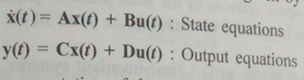
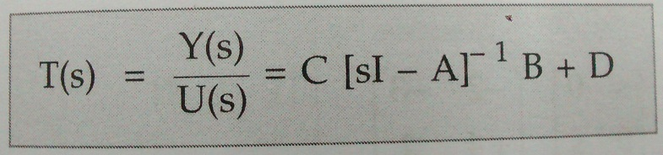
State Model to Transfer Function
State Model
Transfer Function

Slide 60
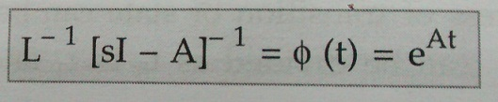
State Transition Matrix
Problem Type: A matrix is given, Find x(t)
Use standard formula;
Imp : 1. Problem can be asked
2. Theory Question- Properties of STM
3. Problems on STM Properties

Slide 61

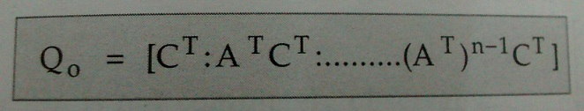
Observability & Controllability
Controllability Matrix
Observability Matrix

Slide 62
Problem statement:- Investigate for complete state controllability and complete state Observability for the system,
Imp : 1. Problem Can be asked
2. Theory Question- Explain Observability & Controllability (Explain in brief with all its conditions)

